Slide 1
City of Blanco Transportation Planning & Advisory Committee (TPAC)
Members:
Kenneth Welch
Jo Nell Haas
Wendy Cambridge
Libbey Aly
Brandon Carlson
Bill Depew
VACANCY

Slide 2
US- 281 Expansion Alternatives
TxDOT Status
TPAC - Current Approach and Status
Project Timeline
Q & A

Slide 3
TxDOT Status
Oct. 2024 - TxDOT will reduce options to one Relief Route and a No Build option
No Build cannot be eliminated until evaluated
Begin detailed route studies
Preliminary design & connection alternatives
Environmental Impact Studies

Slide 4
Four Alternate Routes will be reduced to one or a combination of the known routes Connection alternatives and interchange design options for the selected route will be evaluated Environmental Impact studies will be performed along the selected relief route and the No-Build route Every historic, environmental, or biological feature must be investigated by TxDOT

Slide 5
National Historic Preservation Act (NHPS) & National Environmental Protection Act (NEPA)
require evaluation of potential historic & environmental resources
Every feature will be scored as to significance and alternative actions to be considered to mitigate or eliminate the threat

Slide 6
TxDOT Evaluation Criteria
Safety
Intersections
roadway safety
driver safety
Congestion
passenger
freight
travel time & traffic
flow
diversion volume
Statewide Connectivity
connections to local & regional roads
Economic Development
population projections
land open for develoment
diverted traffic volumes
local access points

Slide 7
TxDOT Evaluation Criteria
Feasibility, Design, & Engineering
bridges
vertical / horizontal issues
grade seperations
length of route
Preliminary Costs
planning & construction
right of way acquisition
Environmental
right of way needed
parcels impacted
displacements
conservation easements
cemeteries
historic properties
water
noise
dark sky
endangered species

Slide 8
Historical, Environmental & Biological features
Over 800 features provided to TxDOT
every feature has a GIS location and description
TxDOT must evaluate every feature within a proposed route

Slide 9
TPAC Approach and Status
Learn from other communities (studies & models)
Use data to inform recommendations and decisions
Predict potential outcomes for a Blanco Relief Route and a No Build route
Develop mitigation actions
Advise City Council and work with committees to implement actions
Engage the public to drive future outcomes

Slide 10
Reviewed Case Studies of Bypassed Cities
Studies are a look back at outcomes
18 communities (Indiana, Wisconsin, Kentucky)
Motives for bypasses varied
Severe congestion, declining economy, or transportation corridor improvement
Studies reviewed traffic, economic, lifestyle, environmental, and demographic impacts
Every situation is different
Plan for the future, don’t forget your CBD

Slide 11
Reviewed Models Predicting Outcomes
Models are a prediction of the future
Three models (2 UT, Rand Corp.), with Tx. cities
cities with a relief route - others without
only economic impacts; projections predict short term sales drops in gas stations & restaurants
All studies and models emphasize planning for impacts
Local leadership can develop mitigating actions to protect the Central Business District

Slide 12
TPAC Approach and Status
Review County and City Plans
County Trans. & Economic Development Plan needs updated growth projections (2021)
Comprehensive Master Plan needs clarity & updated input on a shared vision for Blanco (2020)
Review additional reports & possible mitigation actions
UT Transportation Planning - use of the models
TxA&M Transportation institute

Slide 13
TPAC Approach and Status
Blanco specific data
Traffic Projections - more than double by 2050; 61% is pass through traffic √
Population growth projections - Tx. growth 1.8% / yr.; Blanco Co. is at 4.8% & over 3% for recent years. √
City sales tax revenue from businesses √
Per capita sales for models (gathering data)
Work with Local Businesses likely to be impacted

Slide 14
TxDOT Traffic Split and Forecast
Vehicles that STOP for over 5 minutes are considered local traffic
61% of current traffic is pass through traffic
Truck traffic currently averages 6% ADV; Varies daily from 2% to 12%

Slide 15
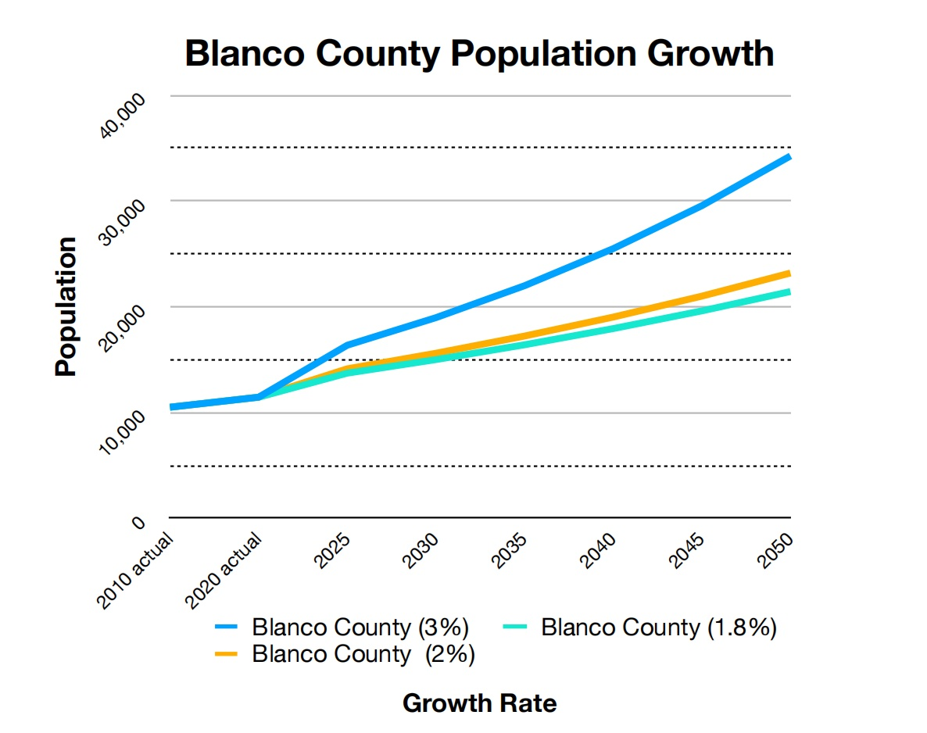
US Census Data and Growth Projections
Texas’ annual growth rate is 1.55%; projected 1.8% through 2050
Blanco Co. current growth is 4.88%; (4.55% - 2021 -current)
2024 Blanco Co. population is 13,685
City growth rate is 4.85%
City population is 2,075
I-35 corridor is projected to grow by 3.1 million by 2050

Slide 16
Potential Loss of Local Sales Revenue
Models estimate sales drop in highway oriented Retail and Food Sectors
Gas stations / convenience stores may experience a sales loss of up to15%
Restaurant sales may experience a 10% -15% loss in sales
Only businesses dependent on pass through traffic should expect this
level of lost sales
These estimates are averages and are generic
Must be updated using Blanco source data
Business input is necessary to validate
Population growth will partially offset lost sales
Population is the most important component of local business
More residents generate more sales

Slide 17
14 industry sectors contribute to sales tax revenue
Retail & Food Service contain businesses that will be impacted by lost traffic
City sales tax revenue will drop 2.4% - 6.9% with relief route
($33,065 - $93,633)
Other businesses will see negligable lost business

Slide 18
Food Sector Tax
Sales Tax Revenue & projected loss from Food Sector
Max. loss - $39,243
Min. loss - $10,123

Slide 19
Gas & Convenience Store Tax
Sales Tax Revenue & projected loss from the Retail Sector
Max. loss - $54,390
Min. loss - $22,942
TOTAL TAX LOSS RANGE = ($33,065 to $93,633)

Slide 20
TPAC Approach and Status
Further evaluate reduced sales and revenue loss
Develop Potential Mitigating Actions
Environmental, Economic, and Quality of Life
Work with TxDOT on Design Features
Mitigating Features in Design
Riparian Zones, Landscaping
Sound Barriers, Dark Sky
On No build - stop lights, pedestrian crossing...

Slide 21
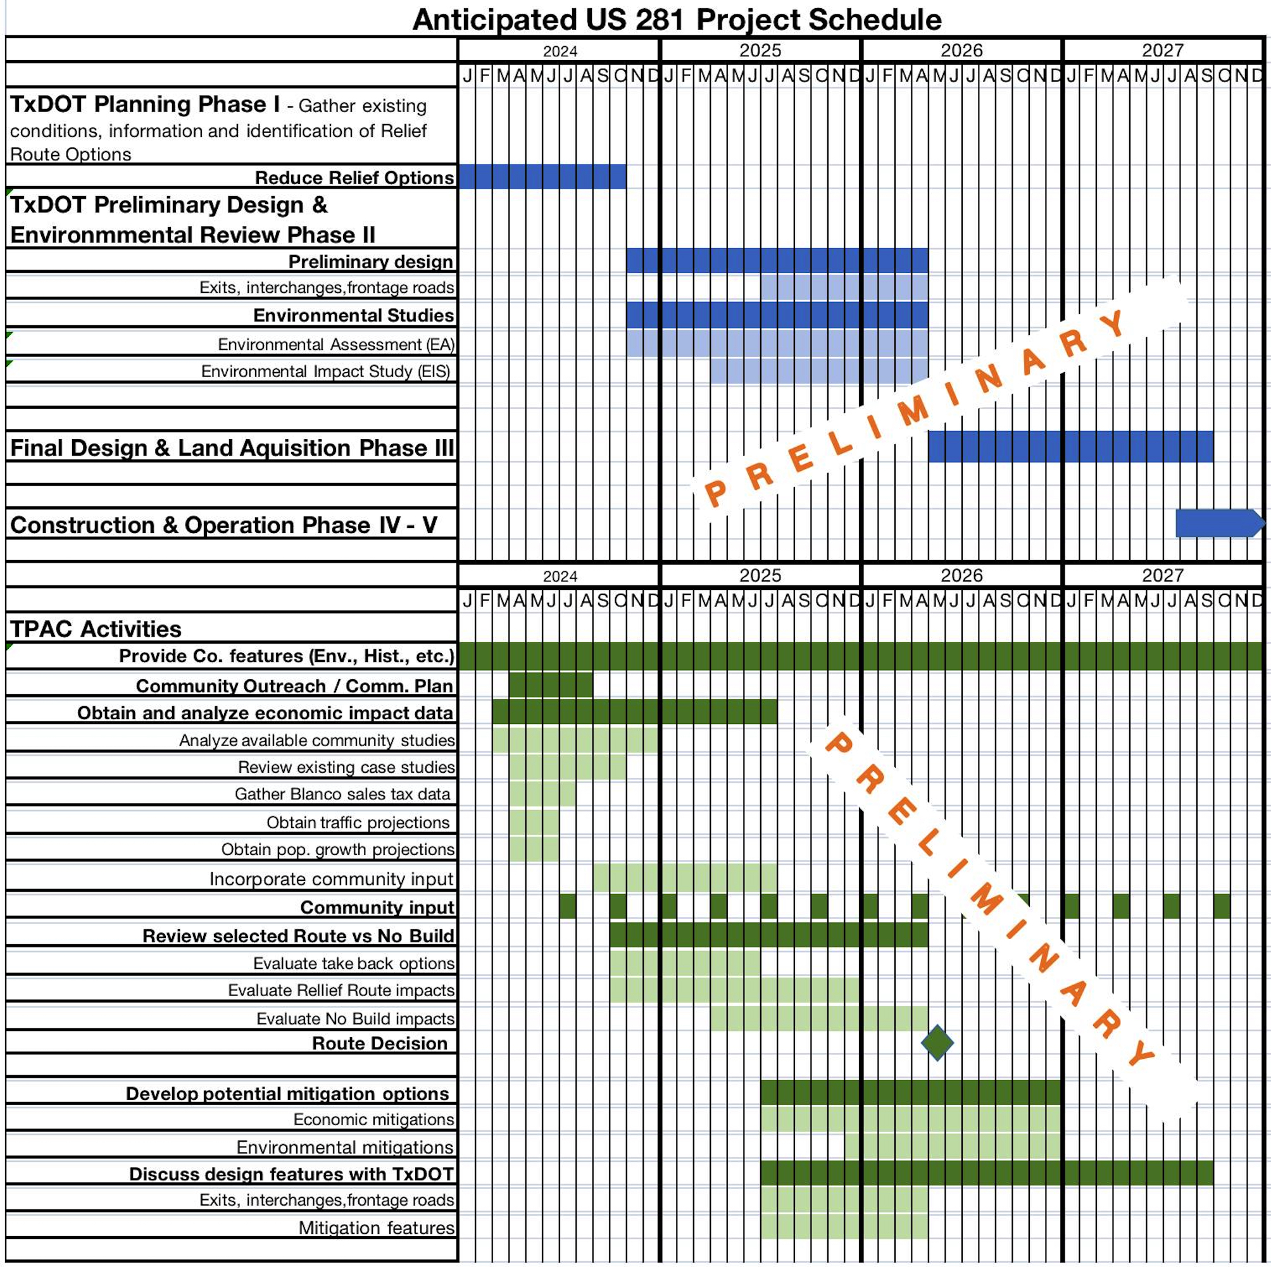
TPAC to follow TxDOT schedule to ensure:
City input is considered
City Committees can develop mitigating actions where appropriate
City Council Can Act

Slide 22
TPAC Approach and Status
Communication Plan
Provide Regular Public Updates (workshop / forums)
Coordinate with all City committees and Chamber of Commerce

Slide 23
TPAC Next Steps
Evaluate No Build & Relief Route
Traffic impacts
vehicle & pedestrian safety
economic
quality of life & land usage
Work with TxDOT on designs
Work with city committees & Chamber of Commerce
Advise City Council & public of progress
Maintain contact with public (workshops, emails, etc.)

Slide 24
Q & A

