Slide 1
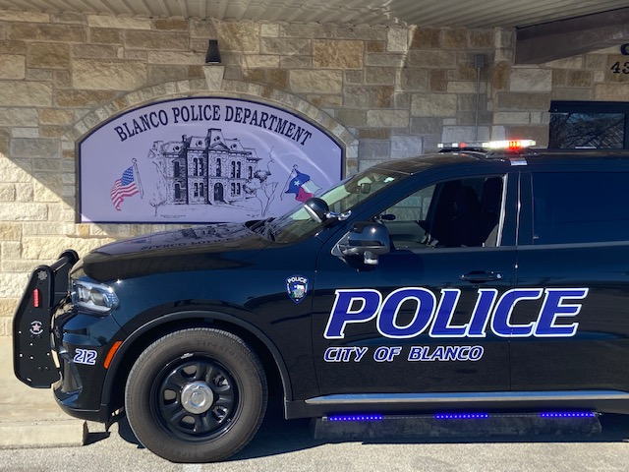
BLANCO POLICE DEPARTMENT
2021 ANNUAL REPORT

Slide 2
TABLE OF CONTENTS
MESSAGE FROM THE CHIEF – PG. 3
MISSION STATEMENT – PG. 4
A RECOGNIZED LAW ENFORCEMENT AGENCY – PG. 5
TABLE OF ORGANIZATION – PG. 6
STAFF / ADMINISTRATION – PG. 7
PATROL – PG. 8-9
K-9 UNIT – PG. 10
CRIMINAL INVESTIGATIONS DIVISION – PG. 11
SCHOOL RESOURCE OFFICER – PG. 12
IN-SERVICE TRAINING – PG. 13
FORMAL EDUCATION – PG. 14
COMMUNITY SERVICE – PG. 15
CRIME STATISTICS – PG. 16-27

Slide 3
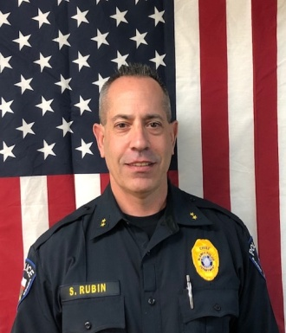
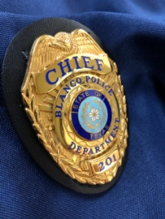
MESSAGE FROM THE CHIEF
Mayor, City Council, and Citizens of Blanco, I am pleased to present you with the Blanco Police Department 2021 Annual Report.
This report highlights many of the accomplishments, initiatives, and programs involving the dedicated men and women of your Blanco Police Department. This report also includes a statistical review of reported crime, calls for service, traffic data and numbers and types of arrests. Our city continues to successfully deter crime through proactive patrol, and community policing initiatives. This success is the result of our very talented sworn and civilian members and the high level of involvement by members of our community. I am greatly honored to work with such a talented and committed team of officers and civilian staff.
Our commitment is to keep this community safe and protect our citizen’s which is the basic foundation of policing. We are especially mindful that every police department needs to maintain a high level of trust and respect within their respective communities and we work hard at maintaining it and never taking it for granted.
I appreciate the continued support given by our elected officials and residents to the members of this department who put service before self on a daily basis. Your Blanco Police Department is committed to many years of continued service doing our part to make Blanco the safest place to live, work and visit.
Very Respectfully,
Scott Rubin
Chief of Police

Slide 4
MISSION STATEMENT
THE MISSION OF THE BLANCO POLICE DEPARTMENT IS TO BE RESPONSIBLE TO OUR COMMUNITY, THROUGH THE PROACTIVE ENFORCEMENT OF LAWS, THE PROTECTION OF LIFE, PROPERTY AND THE MAINTAINING OF ORDER WHILE AFFORDING DIGNITY AND RESPECT TO THOSE WE SERVE. WE WILL STRIVE TO MEET THE PRESENT AND FUTURE NEEDS OF THE PUBLIC THROUGH COMMUNITY, PARTNERSHIP AND INNOVATION.
VISION STATEMENT
TO BE THE SAFEST CITY TO LIVE, WORK AND VISIT.

Slide 5
A Recognized Law Enforcement Agency
The Blanco Police Department is a Recognized Law Enforcement Agency – a designation awarded by the Texas Police Chiefs Association Foundation as part of its Law Enforcement Recognition Program – which signifies the department’s adherence to the 170 Texas Law Enforcement Best Practices.
Becoming a Recognized Law Enforcement Agency
The Law Enforcement Recognition Program is a voluntary process in which police agencies in Texas prove their compliance with Texas Law Enforcement Best Practices.
The Blanco Police Department received its recognition on June 1, 2021.
The Law Enforcement Recognition Program evaluates a police department’s compliance with the 170 Texas Law Enforcement Best Practices as noted by the TPCAF. These best practices were carefully developed by Texas law enforcement professionals to assist agencies in the efficient and effective delivery of service and the protection of individual rights.
These best practices cover all aspects of law enforcement operations including use of force, protection of citizen rights, vehicle pursuits, property and evidence management, and patrol and investigative operations.
This voluntary process required the Blanco Police Department to conduct a critical self-review of the agency’s policies, procedures, facilities, and operations. In addition, the executive order on police reform from the President of the United States has been included in the department’s policies.
Currently, approximately 180 out of 2,200 policies agencies are recognized in Texas. The Blanco Police Department’s hope is this process of an independent review of operations will assure citizens that their Police Department is conforming to the current best practices in law enforcement.

Slide 6
TABLE OF ORGANIZATION
Chief of Police
LT
Administrative
Assistant
CID
SRO
DAY SHIFT
NIGHT SHIFT
K-9
DAY SHIFT
NIGHT SHIFT
NIGHT SHIFT
NIGHT SHIFT
RESERVE
OFFICERS

Slide 7
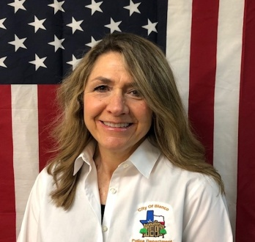
STAFF
The Blanco Police Department is currently authorized 10 Full Time Commissioned Police Officers, 1 Non-Paid Commissioned Police Officer and 1 Civilian Staff. The Department is comprised of 4 sections: Administration, Patrol, Investigations and School Resource Officer.
ADMINISTRATION
Administration is comprised of the Chief of Police, The Lieutenant, and the Department’s Administrative Assistant. Administrative Staff is responsible for every function of the Department including; scheduling, payroll, training, records, complaints, budgeting, and implementing policies to create an efficient and professional Police Department.
Chief Scott Rubin
25.6 Years of Service
Master Peace Officer
Masters of Public Administration
Lieutenant Jerry Thornhill
21.9 Years of Service
Master Peace Officer
Robin Nies - Administrative Assistant – 4 Years of Service
BBA in Marketing Texas Tech

Slide 8
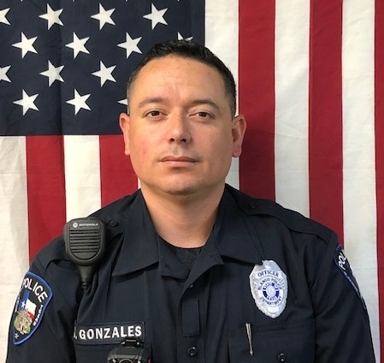
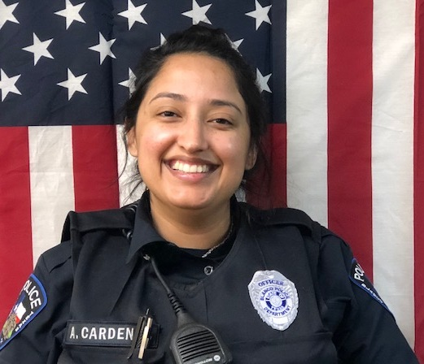
PATROL
The Patrol Division is the largest division in the Department with 6 officers and 1 K9. It is made up of 4 sections with day and night patrol. In every police department across the United States this division is considered the “backbone” of the agency. The patrol officers are the most visible police entity within our community, answering the initial call for service when the citizen needs assistance. The types of calls an officer will answer vary in nature and may consist of: crimes in progress, traffic violations including vehicle accidents, public assistance, suspicious persons, and anything else out of the ordinary. Patrol is intended to prevent crime and reduce the fear of the community through their presence.
Marcus Gonzales
6.3 Years of Service
Master Peace Officer
Ysidro Rodriguez
6 .6 years Service
Intermediate Peace Officer
Amanda Cardenas
4.9 Years Service
Intermediate Peace Officer

Slide 9
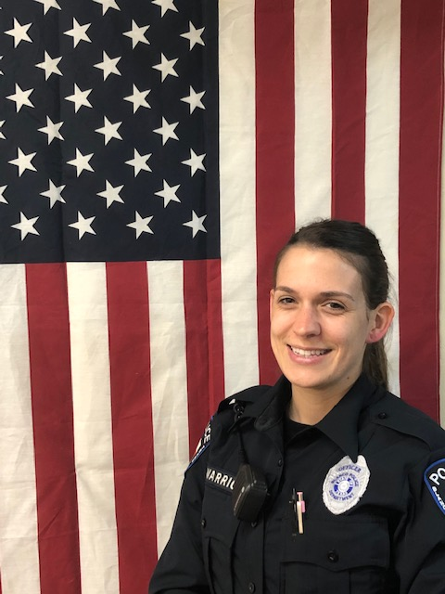
PATROL
Jazmine Salazar
Full Time Peace Officer
11 months service
Brynn Warrick
Full Time Peace Officer
11 months service

Slide 10
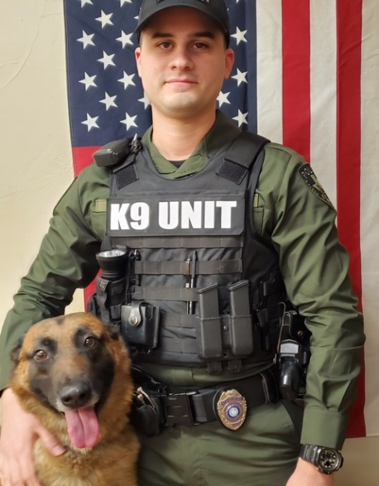
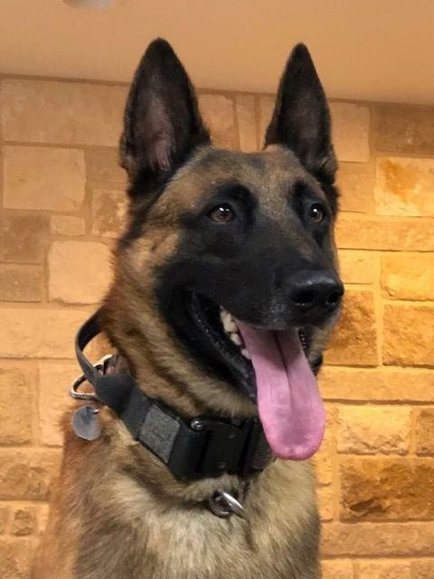
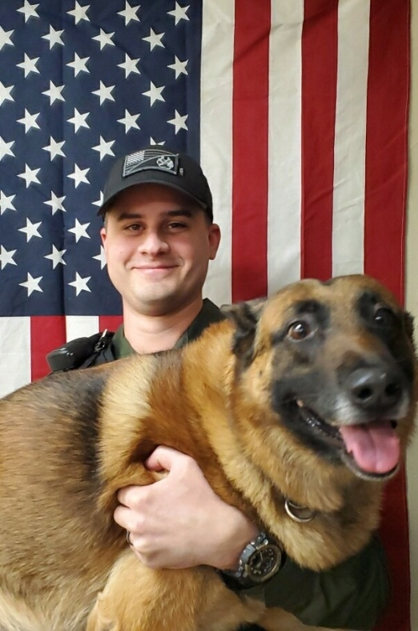
K-9 Unit
The Blanco Police Department K-9 Unit is comprised of one K-9 team; K-9 Maverik with Officer Winn. Maverik is considered sworn in member of the Department and is used to detect Narcotics and to protect his handler if the need arises. Blanco PD’s K-9 program has proved to be an invaluable asset to the Department and has shown excellent success. This K-9 team is currently assigned to Patrol.
Ethan Winn
4.11 Years Service
Intermediate Peace Officer
Bachelors of Criminal Justice
Magna Cum Laude
University of Texas at San Antonio
Maverik – 7 years of age
5 years of service
Officer Winn and Maverik

Slide 11
CRIMINAL INVESTIGATION DIVISION
Criminal Investigations is comprised of 1 Detective that handles numerous functions including investigating criminal offenses, collecting and securing of evidence, court preparation, and much more.
Victoria McMain
CID
6.6 Years of Service
Intermediate Peace Officer

Slide 12
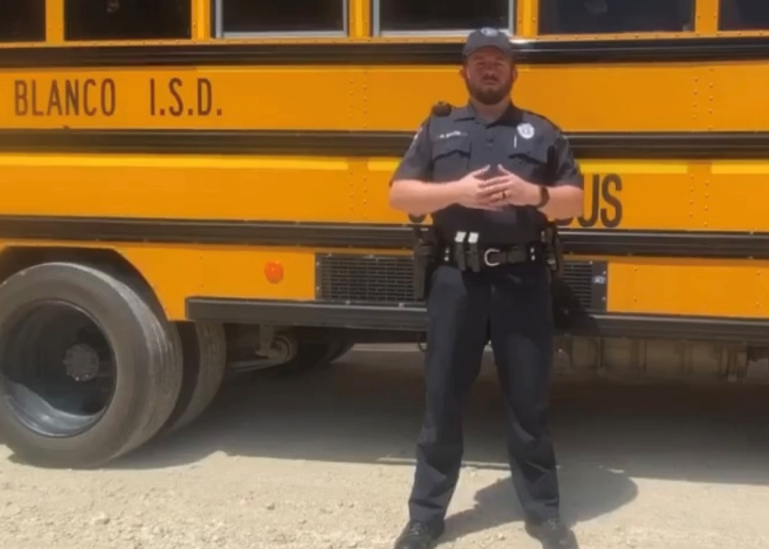
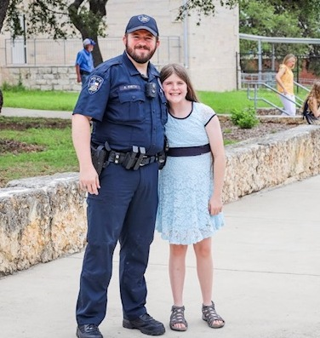
SCHOOL RESOURCE OFFICER
The SRO program consists of 1 Officer. The School Resource Officer program that we have in the City of Blanco has time and again proven its effectiveness and success. The SRO provides an extra safety net in schools by conducting security assessments of school buildings and surrounding areas, teach school lock down procedures and provide critical incident training in school communities. The SRO provides a positive role model for students; especially those without positive role models in their lives.
Austin Smith – 3.10 years of service
Intermediate Peace Officer
Bachelor of Science in Criminal Justice at Texas State University

Slide 13
IN-SERVICE TRAINING
As part of BPD’s in-service training the department is committed to have 100% of our officers certified as Mental Health Officers, with ½ having completed the certification process with a goal of the other half completing in 2022.
Our goal is to connect people with mental health resources without having to make an enforcement action. We want our officers to be able to understand what they’re responding to.
In 2021, Blanco Officers completed over 2000 hours of in-service training through the Texas Commission on Law Enforcement. Training is both mandated and essential for Officers to remain up to date with the most recent knowledge and tactics. Officers must also complete specific courses to advance their Peace Officers Licenses. Currently, the Department’s licensing is as follows:
* 3 Master Peace Officers
* 5 Intermediate Peace Officers
* 2 Licensed Peace Officers
Continual training helps to provide Officers with the knowledge and experience needed to efficiently and professionally serve the residents of Blanco.

Slide 14
FORMAL EDUCATION
The Police Department continually encourages Officers to enroll and continue their education through institutions of higher learning. The Department supports Officer’s efforts to attend Universities, whether in person or online, and provides incentives for Officers to do so.
The Blanco Police Department Officers currently have 1 Master’s Degree, 2 Bachelor’s Degrees and 4 Officers currently enrolled and seeking Bachelor’s Degrees while continuing to work full time for the residents of Blanco.

Slide 15
COMMUNITY SERVICE
Annual Toy Drive
In 2021 the Blanco Police Department
conducted a Toy Drive during the Christmas
Holiday. The Police Department collected
and dropped off hundreds of gifts donated
by the residents of Blanco. The toys were
donated to the Highland Lakes Family Crisis
Center. The Blanco Police Department would
like to thank the Lowes Grocery Store, Old
300 BBQ, Tractor Supply, Security
State Bank and Trust, NAPA Auto
and many neighbors for your
generous donations to our Christmas
toy drive.

Slide 16
CRIME STATISTICS
INCIDENTS/OFFENSES
2020 2021 +/-
AGGRAVATED ASSAULT 0 4 100%
SEXUAL OFFENSES 3 3 --
ASSAULTS 13 13 --
DECEASED PERSONS 5 5 --
MISSING PERSONS 4 5 20%
RUN-A-WAYS 1 5 80%
BURGLARY 11 12 8%
LARCENY/THEFT 31 28 11%
ARRESTS 78 126 38%
BURGLARY BY TYPE & FORCE USED LARCENY/THEFT BY TYPE
FORCE NO FORCE

Slide 17
CALLS FOR SERVICE
2020 2021 +/-
CALLS FOR SERVICE 1123 2965 62%
ASSIST OTHER AGENCY 136 199 32%
ASSIST EMS 50 80 38%
ASSIST BLANCO FIRE 10 25 60%
ACCIDENTS 51 80 36%
DISTURBANCES 49 51 4%
ALARMS 146 178 18%
SUSPICIOUS ACTIVITY 117 262 55%
ASSIST PUBLIC 47 107 56%
TOTAL CALLS FOR SERVICE ASSISTANCE CALLS 2021

Slide 18
ARRESTS AND OFFENSES
2020 2021 +/-
INDIVIDUALS 78 126 38%
OFFENSES 128 182 30 % Resident 6 18 67%
Non Resident 72 108 33%
Felony 79 79 ---
Misdemeanor 49 103 52%

Slide 19
ALCOHOL & NARCOTICS
ALCOHOL VIOLATIONS 2020 2021 +/-
DRIVING WHILE INTOXICATED 6 12 50%
PUBLIC INTOXICATION 2 9 78%
OPEN CONTAINER 17 12 42%
MINOR IN POSS. 1 3 66%
NARCOTICS VIOLATIONS
HEROIN/OPIATES 4 1 30%
COCAINE 4 4 - -
METHAMPHETAMINE 28 16 75%
RX/DANGEROUS DRUGS 2 20 90%
MARIJUANA/THC/HASH 32 56 43%
OTHER 3 0 33%
PARAPHERNALIA 94 90 4%

Slide 20
TRAFFIC STATISTICS
2020 2021 +/-
INDIVIDUALS STOPPED 1848 2160 17%
CITATIONS 682 718 5%
WARNINGS 1873 1442 29%
CITATIONS – RESIDENTS 118 42 64 %
CITATIONS – NON RESIDENTS 564 720 28%
67%

Slide 21
RACIAL PROFILING DATA
TOTAL BREAKDOWN FOR ALL INDIVIDUALS STOPPED
White 1511 69.95%
Hispanic 539 24.95%
African American 66 3.06%
Alaska Native/American Indian 4 .19%
Asian/Pacific Islander 40 1.85%

Slide 22
TOTAL BY GENDER
CONTACTS
FEMALE 718
MALE 1442
RACE/ETHNICITY KNOWN PRIOR TO STOP
YES NO
87 2073
CITATIONS ISSUED BY RACE
CITATION WARNING
WHITE 477 1030
HISPANIC 210 329
AFRICAN AMERICAN 14 52
AK NATIVE/AMER. INDIAN 1 3
ASIAN/PACIFIC IS. 16 24

Slide 23
RACIAL PROFILE DATA PROVIDED BY KOLOGIK COPSYNC MOBILE | % OF STOPS
MALE | 66.76%
FEMALE | 33.24%
ALASKA NATIVE/AMERICAN INDIAN | 0.19%
ASIAN/PACIFIC ISLANDER | 1.85%
BLACK | 3.06%
WHITE | 69.95%
HISPANIC/LATINO | 24.95%

Slide 24
REASON FOR STOP/CONTACT
1756
TYPES OF VIOLATIONS WRITTEN TOTAL SEARCHES FROM TRAFFIC STOPS
CITATIONS WARNINGS
SPEEDING 446 762 TYPE TOTAL
DRIVER’S LICENSE VIOL. 58 62 CONSENT 77
VEHICLE REGISTRATION 87 282 INCIDENT TO ARREST 28
NO INSURANCE 58 54 INVENTORY 0
DISREGARD STOP LIGHT/SIGN 25 77 PROBABLE CAUSE 66
EQUIPMENT VIOLATIONS 3 237 NO SEARCH 1983
CONTRABAND 6

Slide 26
MISC. CALLS FOR SERVICE
2020 2021 +/-
ACCIDENTS 31 80 61%
ALARMS 146 178 18%
CITY ORD. VIOLATION 12 22 45%
ANIMAL CALLS 42 38 11%
HOME WATCHES 1532 1342 49%
MOTOR VEHICLE ACCIDENTS 2020 2021
One Vehicle 4 8 50% Two Vehicles 21 40 48%
Three Vehicles 0 7 100% Truck Tractor 1 2 50% Vehicle Vs. Animal 5 7 29%
ACCIDENTS BY AREA 2021
.07%
42%

Slide 27
ALARM CALLS 2020 2021
911 HANG UP 68 61
ALARM 66 178
FIRE ALARM 12 5
MEDICAL ALARM 38 8
CITY ORDINANCE VIOL. 2020 2021
SIGNS 0 11 FIREWORKS 4 3 SOLICITORS 1 0 JUNK VEHICLE 1 0
ANIMAL AT LARGE 2 3
OTHER 4 5
ANIMAL CALLS 2020 2021
DEER CALLS 6 6
ALL OTHER 33 32

